Slide 1
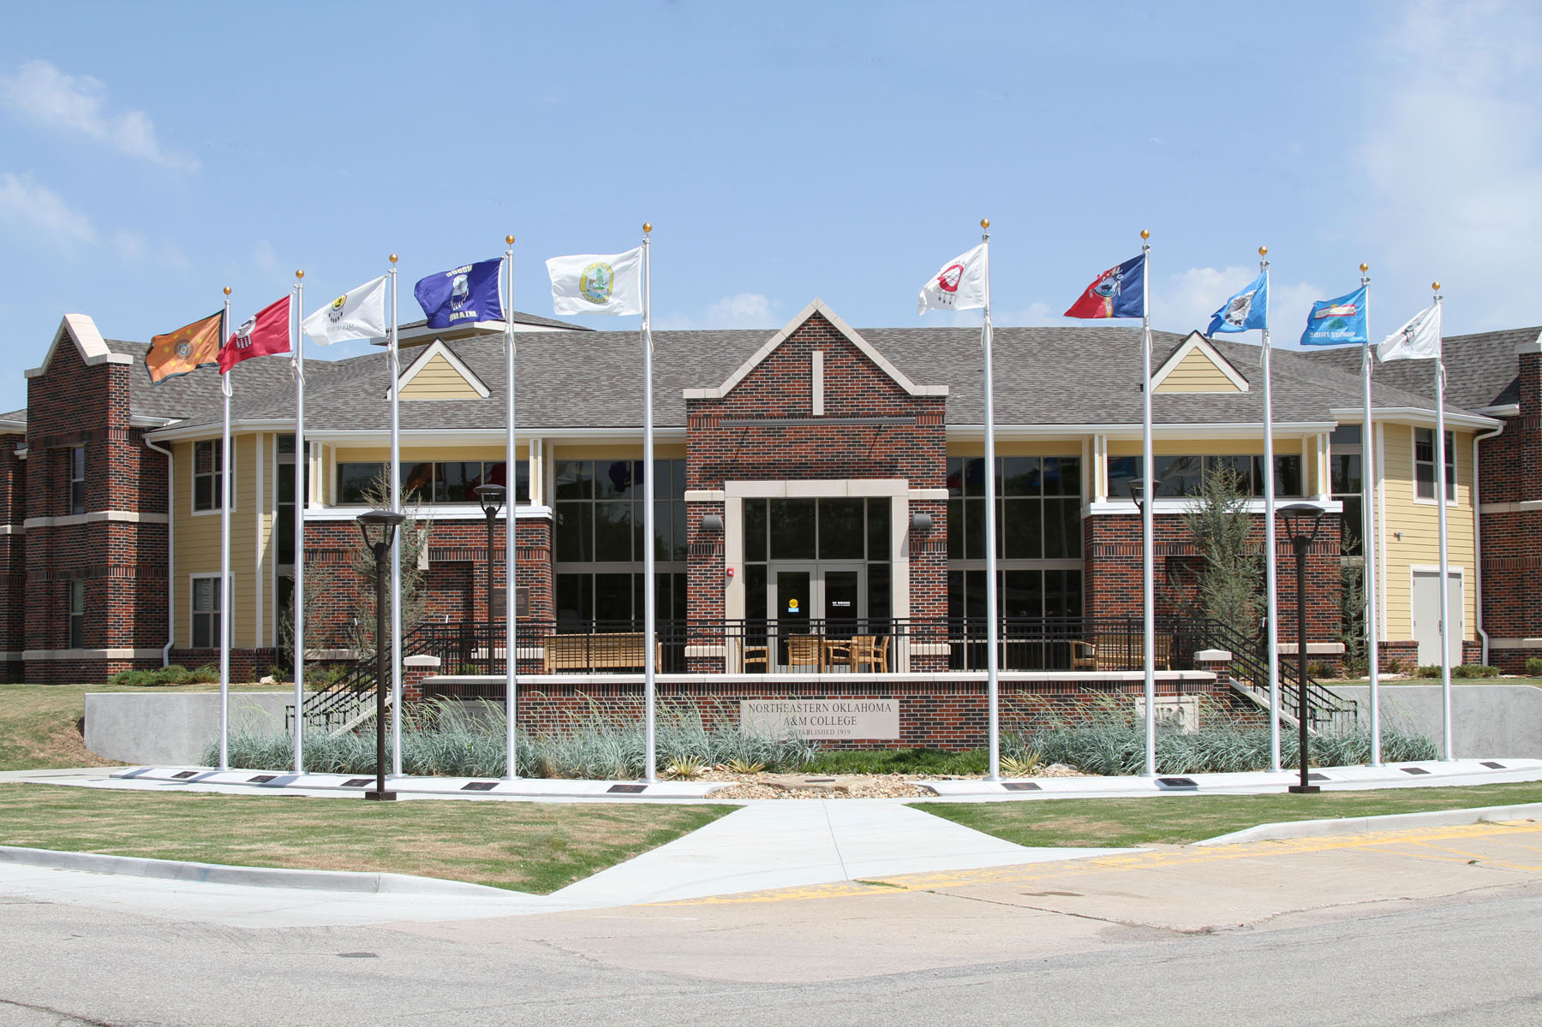



Native Ways of Knowing
Native Opportunities for Retention and Success in Education
July 14, 2012

Slide 2
Barnhardt & Kawagley
“knowing” and “understanding”
Inter-tribal consensus
generalization

Slide 3
Comparison
NWOK
Western Pedagogy
Knowing (verb)
Holistic
Place
Knowledge (noun)
Dissect & disconnect knowledge

Slide 4
Questions
With over 500+ distinct tribal entities, are there correspondingly 500 + Native Ways of Knowing?
Is there an accepted definition of Native Ways of Knowing, and if so, what current research or practices have emerged?

Slide 5
Current Scholarship
Growing number of Native scholars
Changes in venues for such scholarship
The creation of academic journals which target issues and research in Indian Country
(changes in the privileging of voice)
The global access to information as a result of technology

Slide 6
Policies and Practices of Indian Education
Extinction Phase (1492-1870s)
  Fueled by federal policies (Manifest Destiny)
  All Indians were considered the same
Dependency Phase (1870-1920s)
  Move to reservations
  “Civilize”
  This period ends with a Supreme Court ruling that establishes
  American Indians as citizens of the United States
Assimilationist Phase (1930s-1950s)
Termination Phase (1960s-1970s)
Self-Determination (1970s-1990s)
NWOK (1990s +)
  Collaboration globally
  Self-Actualization

Slide 7
Assumptions
Indigenous pedagogy is valued among North American Indian cultures.
NWOK is not a debate about the effects of colonization, but actualizing NWOK in a curriculum is a political act of self-determination.
Among 500+ distinguishable indigenous peoples, there are distinct similarities .
Mainstream scholarship accepts NWOKcl

Slide 8
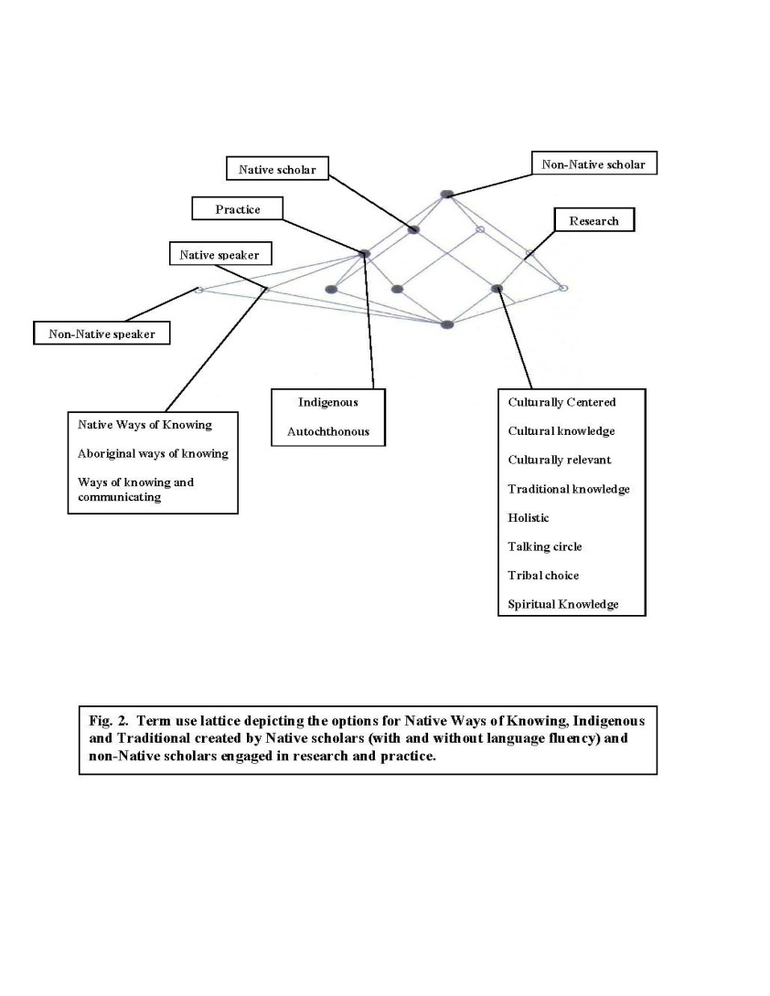
Matrix

Slide 9
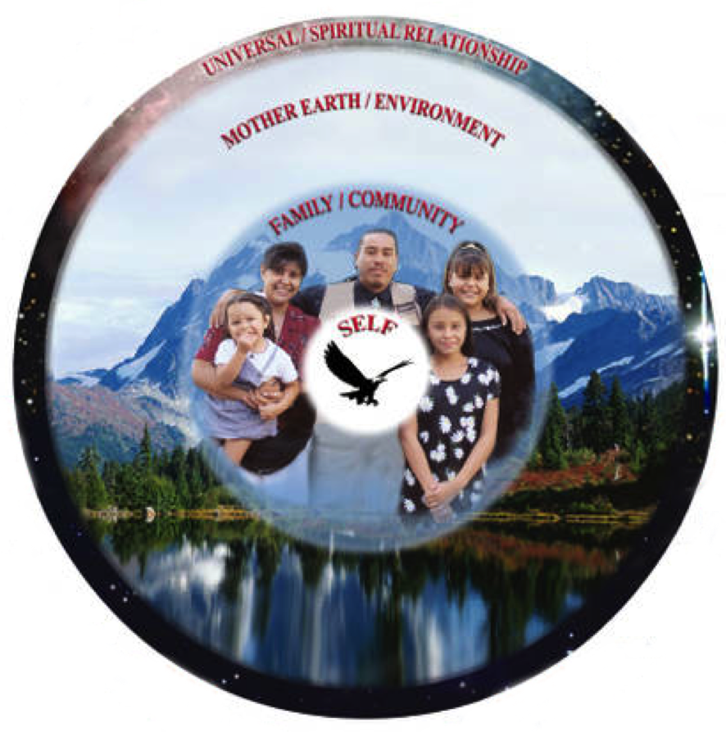

Slide 10
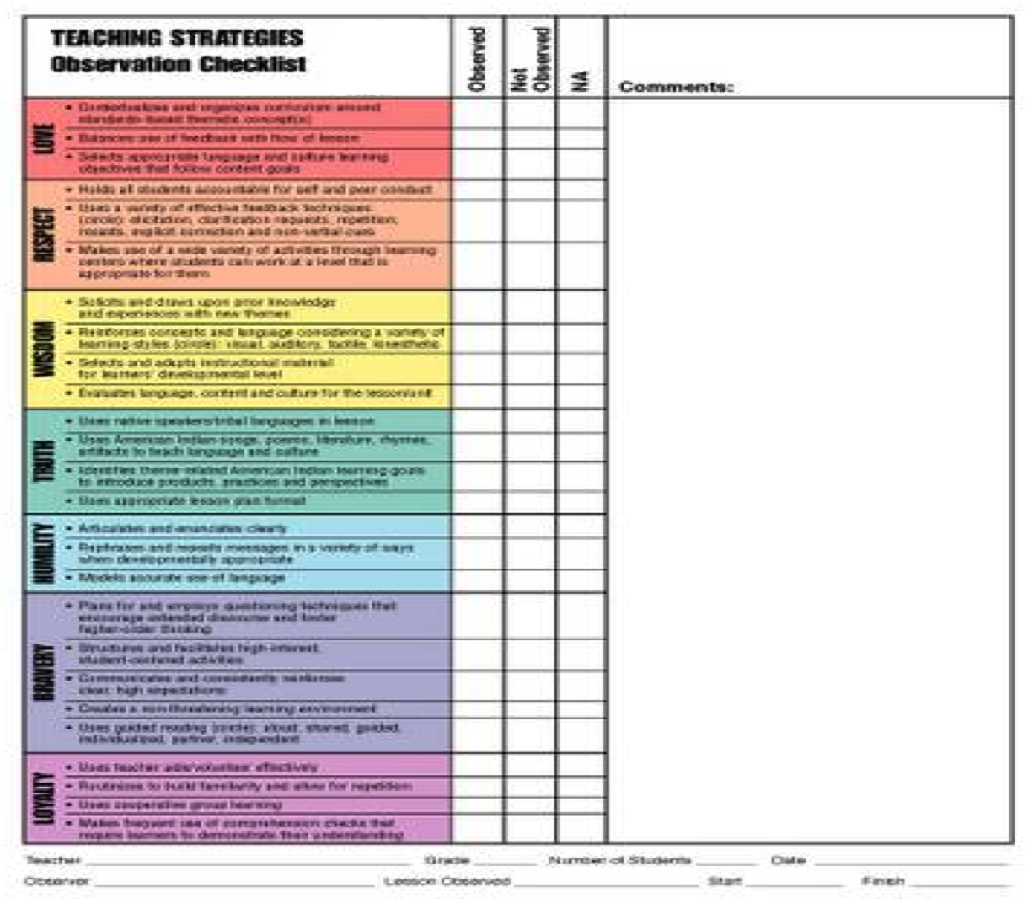

Slide 11
NORSE AT NEO
NORSE
A constructive learning process that encourages authentic exchanges, instructive demonstrations, and an opportunity to focus on important life applications, not just methodology.
Notes:
At NEO Native Ways of Knowing honors the cultural heritage of Northeastern Oklahoma in the NORSE Tradition by asking each of us to take pride in our heritage, and encouraging us to share what we know in a way that is experiential, participatory and fundamental. We will engage in a constructive learning process that encourages authentic exchanges, instructive demonstrations and an opportunity to focus on important life applications, not just methodology. NWOK will emphasize the virtues that honor both the students and instructor as part of a never-ending circle of wisdom to be shared.

Slide 12
Native Opportunities
Place Based Expectation
Notes:
At Northeastern Oklahoma A&M College we honor our own native ways in the NORSE tradition. That means emphasizing Native Opportunities for learning that is purposeful and place specific, while remembering the importance of self-determination in the learning process. There is no set formula for excellence, but students will find that within the context of their classroom experience, in both the traditional classroom and online courses, we can sustain ourselves by focusing on the energy and meaning of what we learn.

Slide 13
RETENTION
Forward Movement
Notes:
To do so we must Retain what is important from our past in balance with the need to move forward as learners and preserve those stories, relationships and tools that serve us as a community. This means trusting our personal experiences and connections to the world while searching for meaning in what we learn, instead of memorizing a formula or method. Technology is a tool that can empower us to connect to the larger world and share our own gifts.

Slide 14
SUCCESS
Degree Completion
Notes:
We can know that we have been Successful in this journey not just when we complete a course or degree program, but when we begin to see education and experience as a dynamic process for communicating and understanding the world. This means recognizing the value of diversity of experience, connecting rather than competing, finding wisdom in the primary resources of our world, and contributing to our community in a meaningful way.

Slide 15
EDUCATION
Lifelong Learning
Notes:
Education is a journey with tangible milestones along each life path. Degree seeking is an important step along a road of life-long learning. This living process challenges each learner to find purpose, incorporate balance, and honor our traditions as we move through every stage of life. The values and practices we learn will sustain us as we pay tribute to the rich legacy we inherit and allow us to define our character, transforming both our own lives and those in our community.

Slide 16
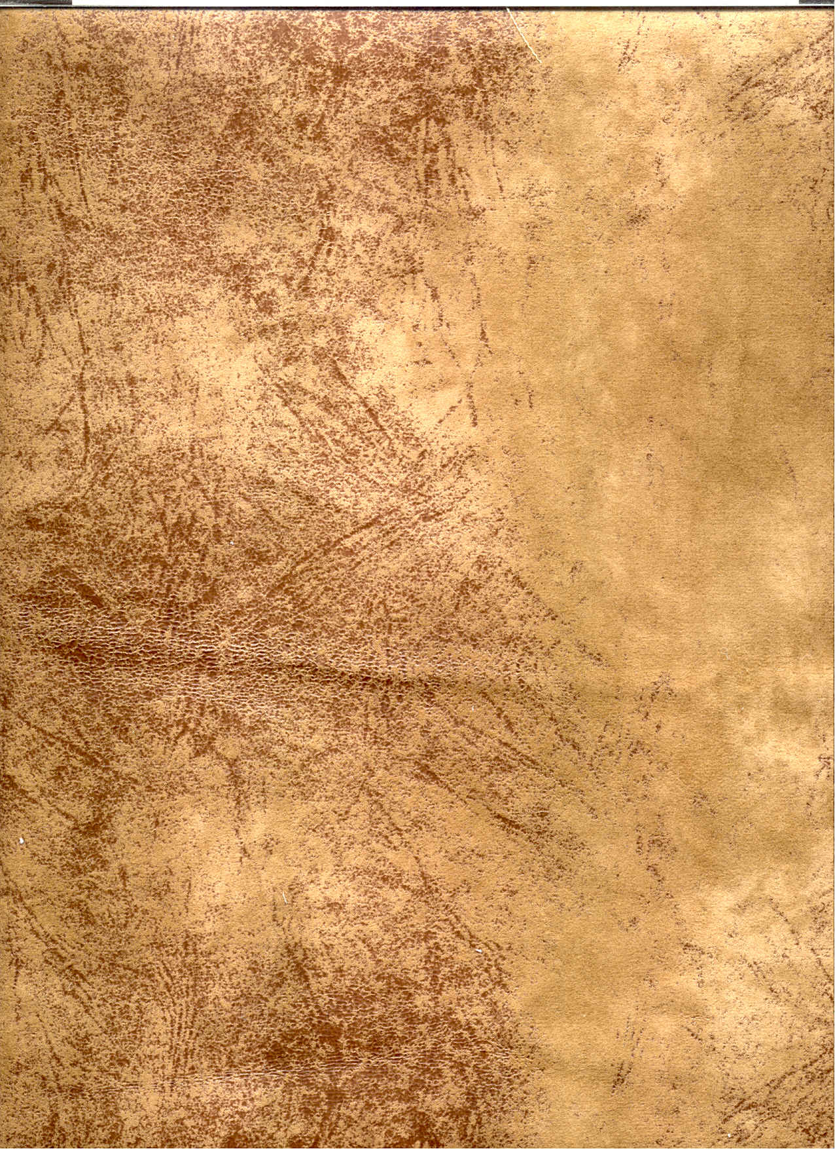
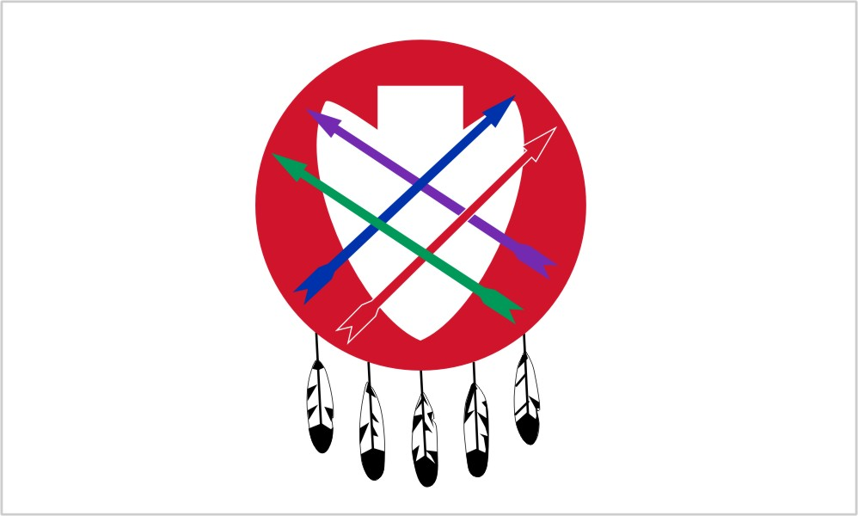









As teachers, we are mentors of our students for all time.
We labor to stand against anger, sadness, criticism, and defeat.
Our hearts shall be full of peace and our minds filled with an urgency for the welfare of our students.
With endless patience, we embrace our duty.
Our firmness shall be tempered with tenderness.
Our words and actions shall be marked by calm deliberation.
Linda Sue Warner, Phd. Naiwen to Talalaka Alfred for his direction to the Gayanashagowe from the Haudenosaunee.

