Slide 1
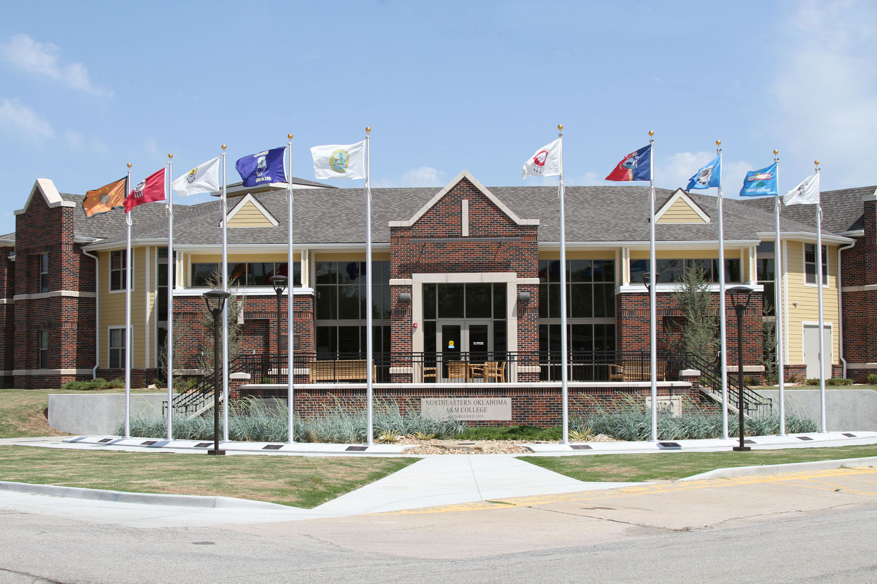


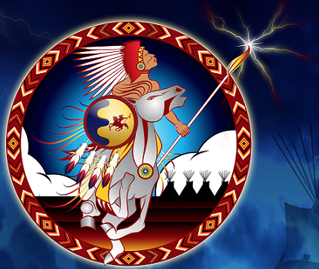

Native Ways of Knowing
Native Opportunities for Retention and Success in Education
August 14, 2012

Slide 2
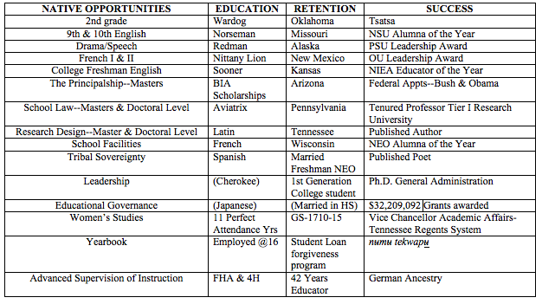

Slide 3
Survey Results
63% of those responding agreed that success at NEO is defined as degree completion.
92% of those responding agreed that Retention was a responsibility they shared with students.
84% of those responding acted as role models for students.
Only 13% of those responding were uncomfortable using technology in the classroom.
2% of those responding indicated they did not follow the policies for referral.
83% of those responding worked with students on career choice.
88% of those responding consider themselves students.
2% of those responding never recommend NEO to their family.
90% of those responding believe our expectations reflect the community and state standards.
4% of those responding believe that students may not be college material.
13% of those responding would never describe NEO as rural and homogeneous.
23% of those responding believe our campus looks much the same as any 2 year campus nationally.
97% of those responding work to prepare students for additional college work.
0% of those responding decline to be involved in continuing education.
2% of those responding never have office hours.
94% of those responding believe in lifelong learning.

Slide 4
Beloit Mindset 2012
The only significant labor disputes in their lifetimes have been in major league sports.
There have nearly always been at least two women on the Supreme Court, and women have always commanded U.S. Navy ships.
They “swipe” cards, not merchandise.
As they’ve grown up on websites and cell phones, adult experts have constantly fretted about their alleged deficits of empathy and concentration.
American tax forms have always been available in Spanish.
Amazon has never been just a river in South America.
Refer to LBJ, and they might assume you're talking about LeBron James.
Life has always been like a box of chocolates.
The Communist Party has never been the official political party in Russia.
“Yadda, yadda, yadda” has always come in handy to make long stories short.
Music has always been available via free downloads.
Grown-ups have always been arguing about health care policy.
Sears has never sold anything out of a Big Book that could also serve as a doorstop.
No state has ever failed to observe Martin Luther King Day..
Public schools have always made space available for advertising.
Charter schools have always been an alternative.
They’ve often broken up with their significant others via texting, Facebook, or MySpace.
Nurses have always been in short supply.
Folks in Hanoi and Ho Chi Minh City have always been able to energize with Pepsi Cola.
“PC” has come to mean Personal Computer, not Political Correctness.

Slide 5
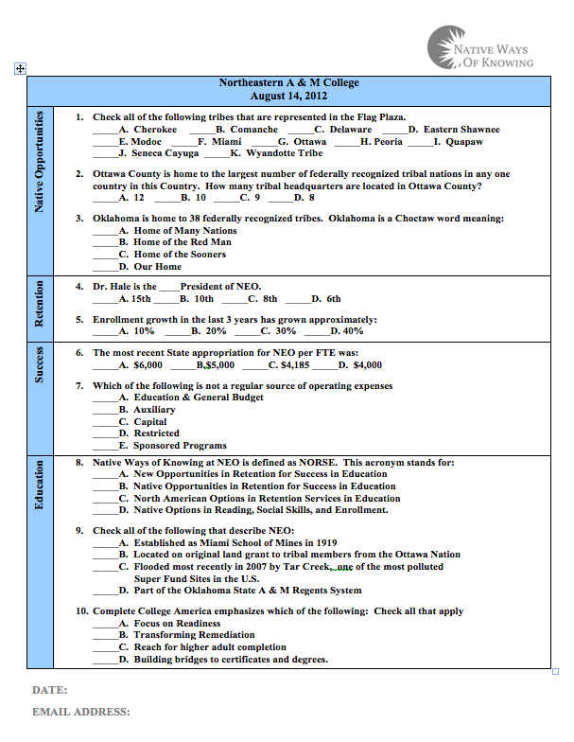

Slide 6
Barnhardt & Kawagley
“knowing” and “understanding”
Inter-tribal consensus
generalization

Slide 7
Comparison
NWOK
Western Pedagogy
Knowing (verb)
Holistic
Place
Knowledge (noun)
Dissect & disconnect knowledge

Slide 8
Background
Indigenous pedagogy is valued among North American Indian cultures.
NWOK is not a debate about the effects of colonization, but actualizing NWOK in a curriculum is a political act of self-determination.
Among 500+ distinguishable indigenous peoples, there are distinct similarities .
Mainstream scholarship accepts NWOK

Slide 9
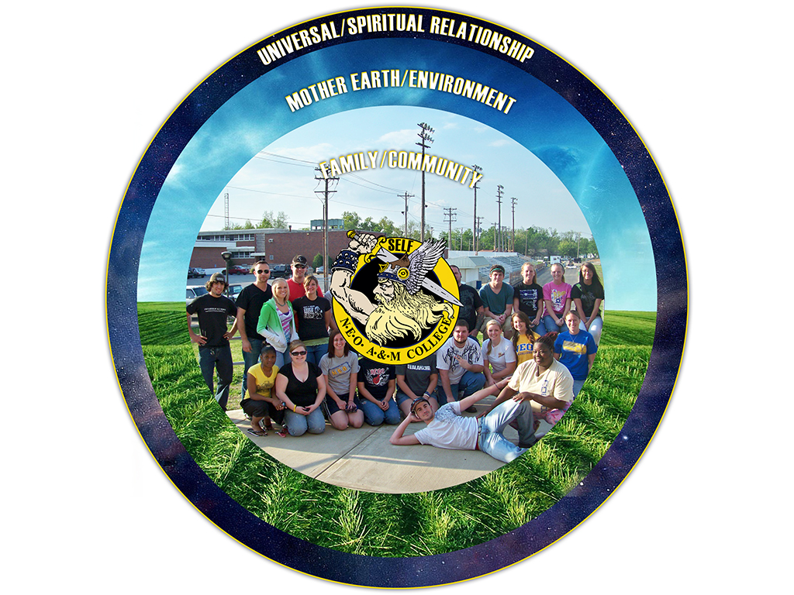

Slide 10
NORSE AT NEO
NORSE
A constructive learning process that encourages authentic exchanges, instructive demonstrations, and an opportunity to focus on important life applications, not just methodology.
Notes:
At NEO Native Ways of Knowing honors the cultural heritage of Northeastern Oklahoma in the NORSE Tradition by asking each of us to take pride in our heritage, and encouraging us to share what we know in a way that is experiential, participatory and fundamental. We will engage in a constructive learning process that encourages authentic exchanges, instructive demonstrations and an opportunity to focus on important life applications, not just methodology. NWOK will emphasize the virtues that honor both the students and instructor as part of a never-ending circle of wisdom to be shared.

Slide 11
Native Opportunities
Place Based Expectation
Notes:
At Northeastern Oklahoma A&M College we honor our own native ways in the NORSE tradition. That means emphasizing Native Opportunities for learning that is purposeful and place specific, while remembering the importance of self-determination in the learning process. There is no set formula for excellence, but students will find that within the context of their classroom experience, in both the traditional classroom and online courses, we can sustain ourselves by focusing on the energy and meaning of what we learn.

Slide 12
RETENTION
Forward Movement
Notes:
To do so we must Retain what is important from our past in balance with the need to move forward as learners and preserve those stories, relationships and tools that serve us as a community. This means trusting our personal experiences and connections to the world while searching for meaning in what we learn, instead of memorizing a formula or method. Technology is a tool that can empower us to connect to the larger world and share our own gifts.

Slide 13
SUCCESS
Degree Completion
Notes:
We can know that we have been Successful in this journey not just when we complete a course or degree program, but when we begin to see education and experience as a dynamic process for communicating and understanding the world. This means recognizing the value of diversity of experience, connecting rather than competing, finding wisdom in the primary resources of our world, and contributing to our community in a meaningful way.

Slide 14
EDUCATION
Lifelong Learning
Notes:
Education is a journey with tangible milestones along each life path. Degree seeking is an important step along a road of life-long learning. This living process challenges each learner to find purpose, incorporate balance, and honor our traditions as we move through every stage of life. The values and practices we learn will sustain us as we pay tribute to the rich legacy we inherit and allow us to define our character, transforming both our own lives and those in our community.

Slide 15
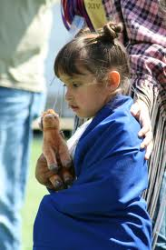
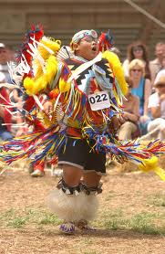
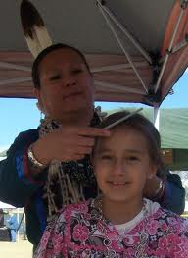
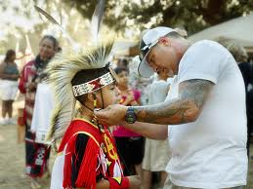
Does one way of life have to die so another can live?

Slide 16
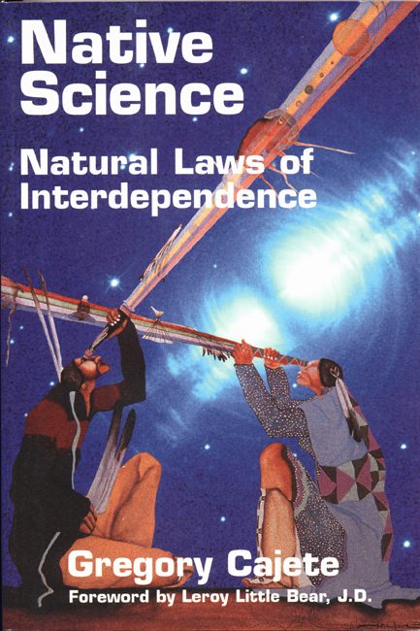

Slide 17
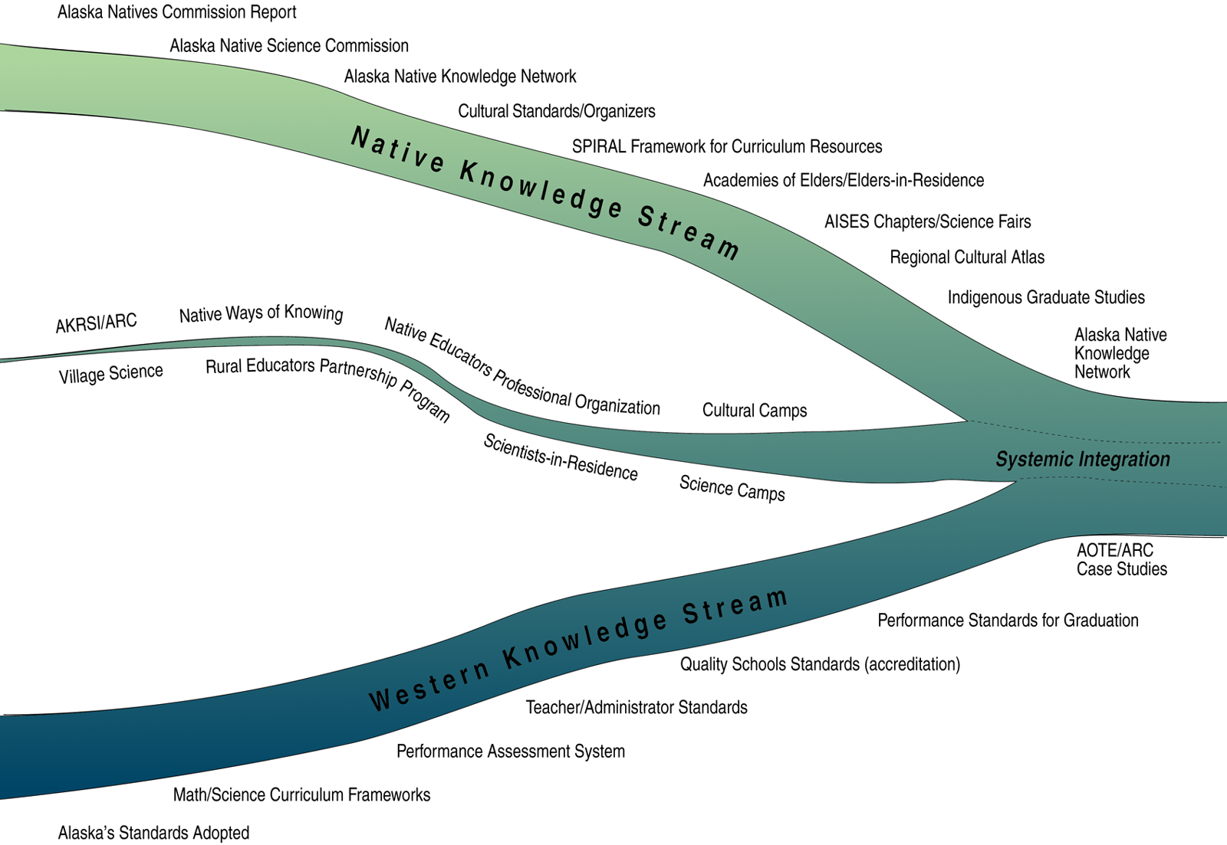

Slide 18
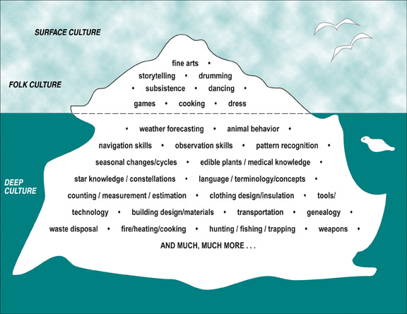

Slide 19
NEO Core Values
Success – NEO endeavors to assist individuals in achieving success in learning and preparing for their future.
Diversity – NEO values diversity and promotes a culture of understanding for other’s differences of opinion, manner of life, freedom of expression, and talents.
Quality and Integrity – NEO is committed to providing quality and integrity in everything we do.
Service – NEO believes that serving others is a noble and worthy cause.
Accountability – NEO accepts the responsibility for being accountable for the use of resources and achieving the desired outcomes expected by those with an interest in NEO A&M College.

Slide 20
Cultural Standards
Assertion:
Culturally knowledgeable individuals are well grounded in the cultural heritage and traditions of their community
Indicators: To meet this standard individuals are able to:
recount their own genealogy and family history;
assume responsibility for their life-long role in relation to the well-being of the community;
practice their traditional responsibilities to the surrounding environment;
acquire and pass on the cultural traditions of their community through oral and written history.

Slide 21
Curricular Elements in Traditional Knowledge
Weather forecasting
Animal behavior
Navigation skills
Observation skills
Pattern recognition
Seasonal changes/cycles
Edible plants/diet/nutrition
Food preservation/preparation
Rules of survival/safety
Medicinal plants/herbal knowledge
Star knowledge/constellations
Language/terminology/concepts
Counting/measurement/estimation
Clothing design/insulation
Tools/technology
Building design/materials
Transportation
Genealogy
Waste disposal
Fire/heating/cooking
Hunting/fishing/trapping
Weapons

Slide 22
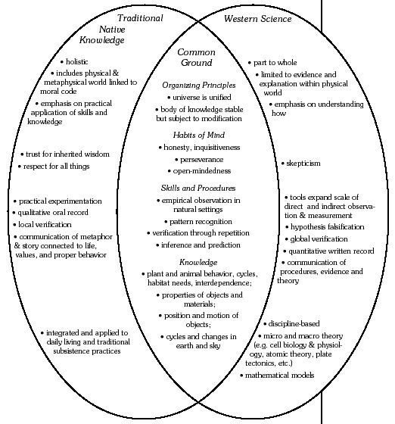
Indigenous Knowledge/Western Science

Slide 23
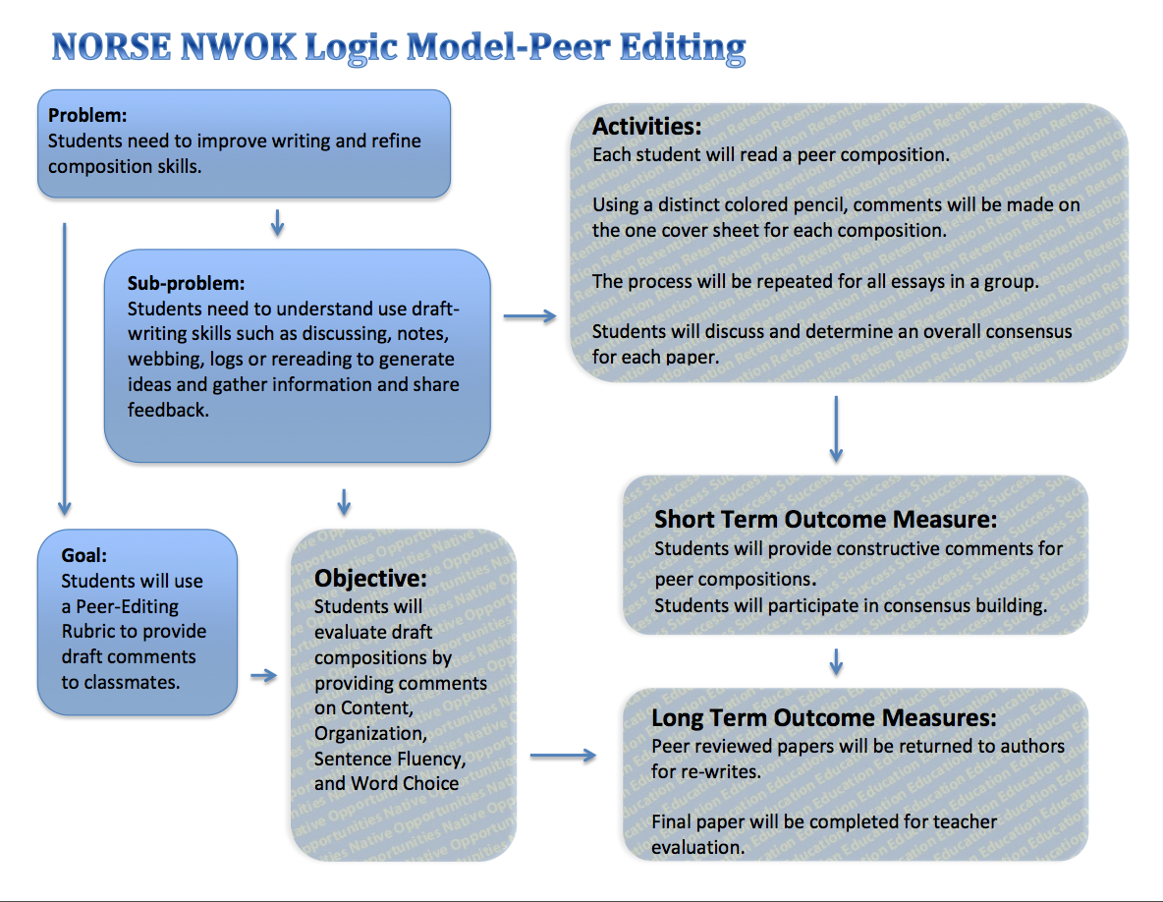

Slide 24
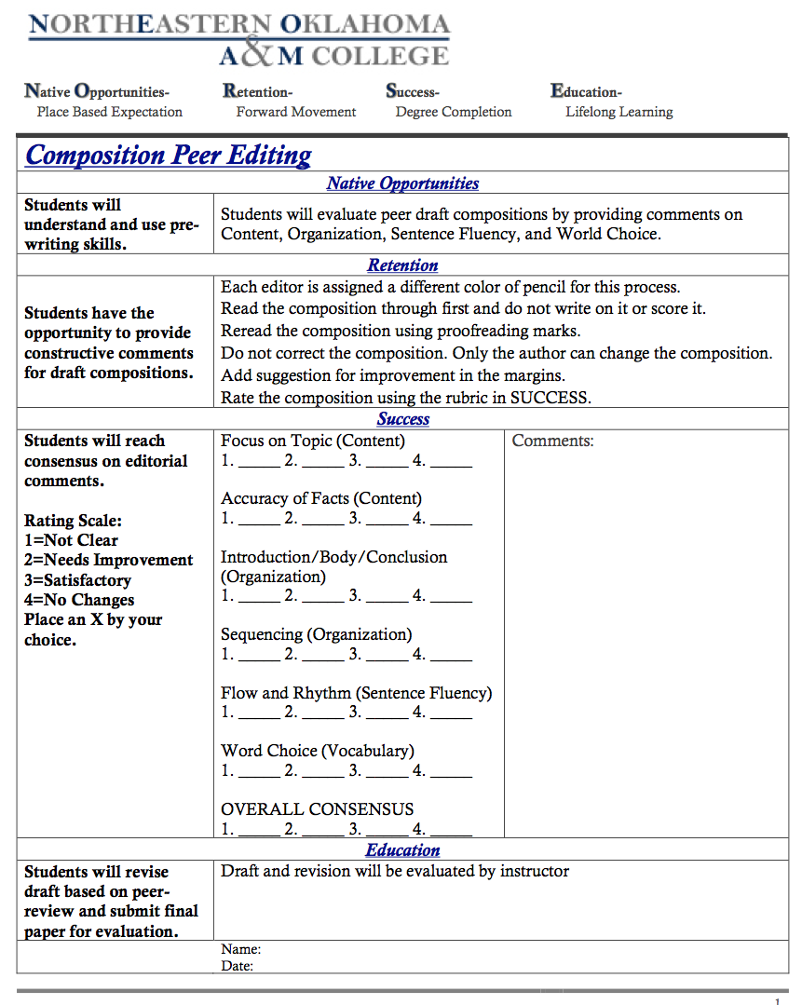

Slide 25
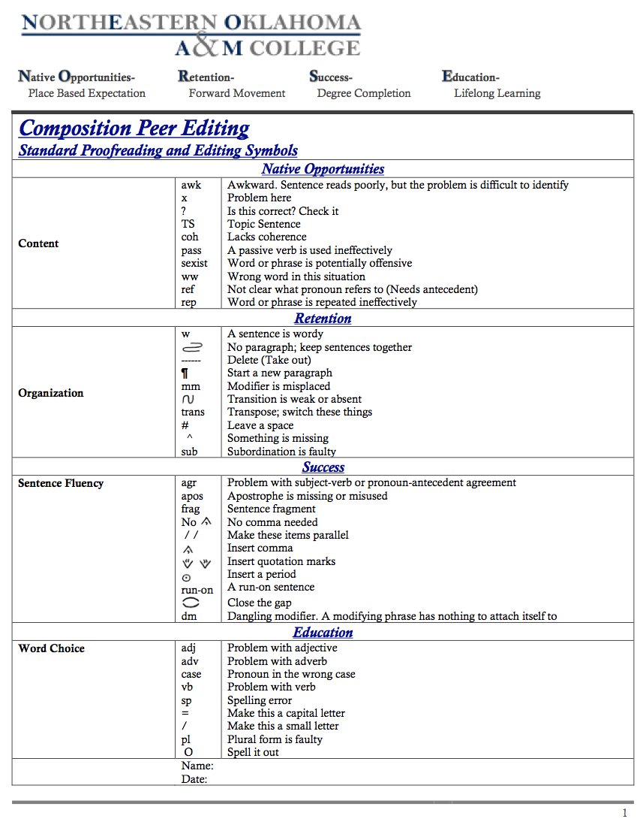

Slide 27

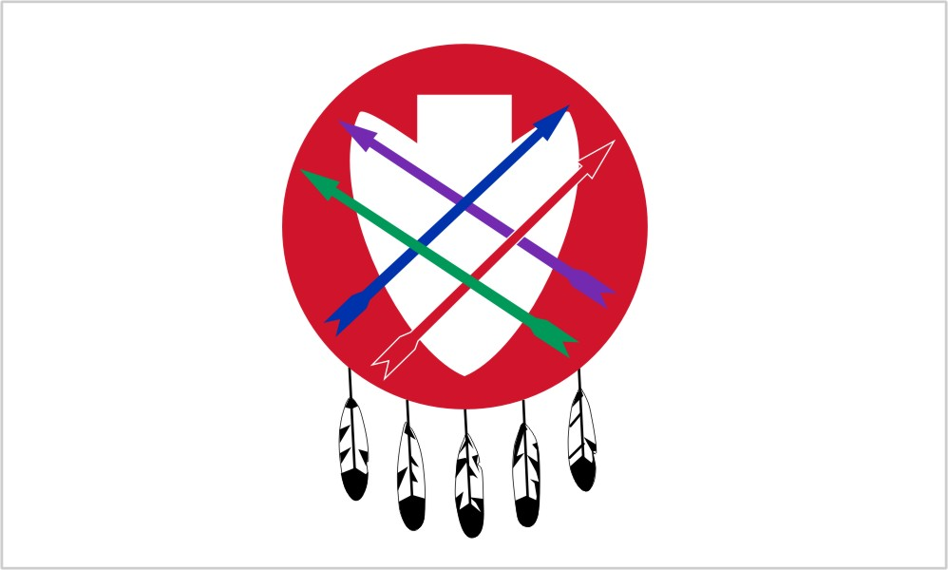









As teachers, we are mentors of our students for all time.
We labor to stand against anger, sadness, criticism, and defeat.
Our hearts shall be full of peace and our minds filled with an urgency for the welfare of our students.
With endless patience, we embrace our duty.
Our firmness shall be tempered with tenderness.
Our words and actions shall be marked by calm deliberation.
Linda Sue Warner, Phd. Naiwen to Talalaka Alfred for his direction to the Gayanashagowe from the Haudenosaunee.

Slide 28
