Slide 1
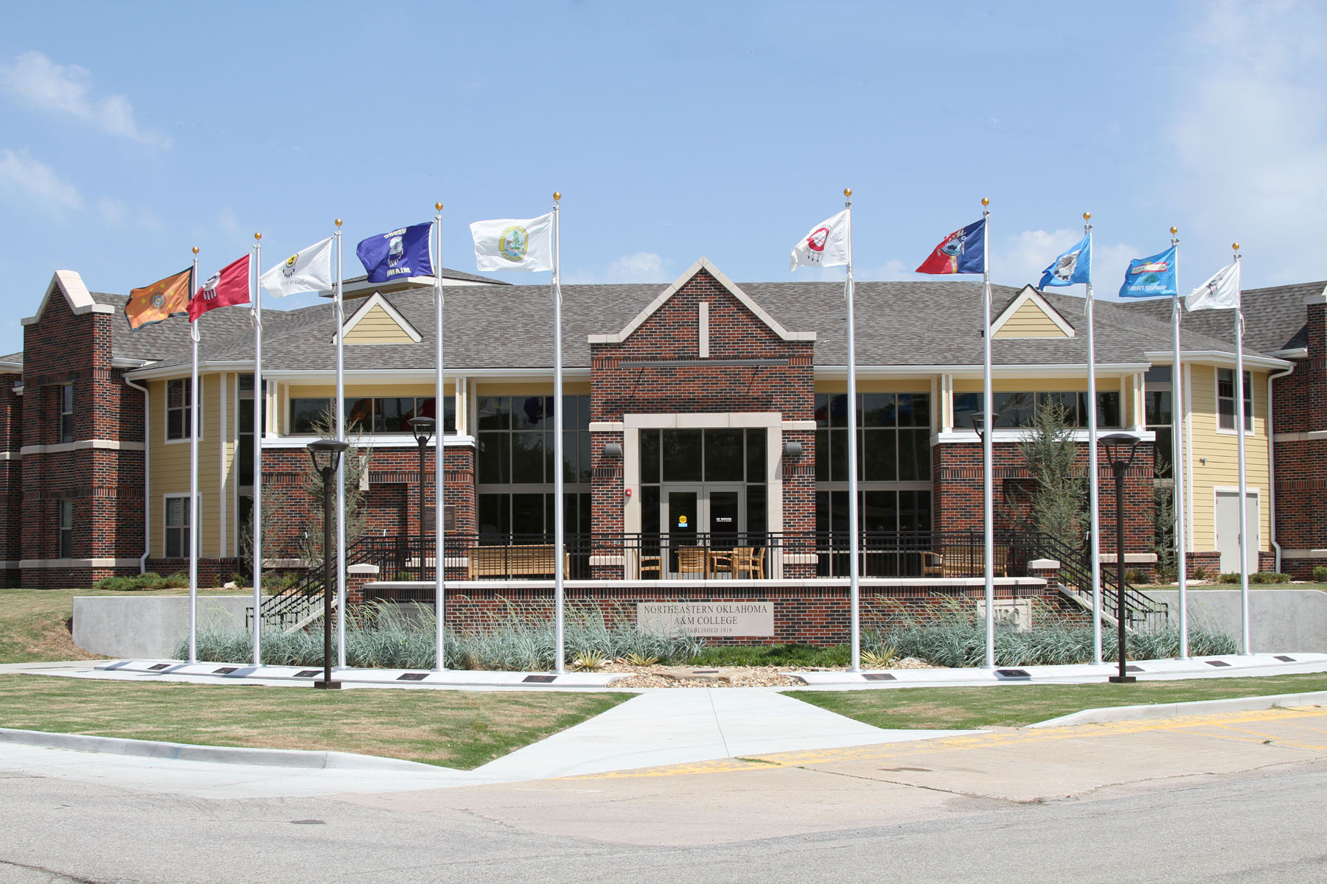



Culturally Responsive Pedagogy
Native Opportunities for Retention and Success in Education
November 29, 2012

Slide 2
Barnhardt & Kawagley
“knowing” and “understanding”
Inter-tribal consensus
generalization

Slide 3
Comparison
NWOK
Western Pedagogy
Knowing (verb)
Holistic
Place
Knowledge (noun)
Dissect & disconnect knowledge

Slide 4
Background
Indigenous pedagogy is valued among North American Indian cultures.
NWOK is not a debate about the effects of colonization, but actualizing NWOK in a curriculum is a political act of self-determination.
Among 500+ distinguishable indigenous peoples, there are distinct similarities .
Mainstream scholarship accepts NWOK

Slide 5
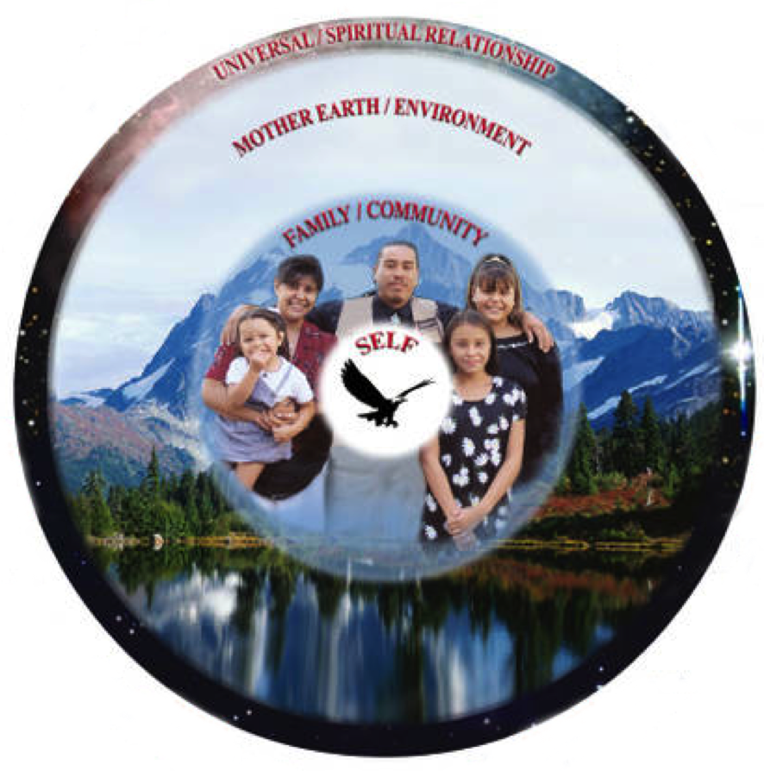

Slide 6
NORSE AT NEO
NORSE
A constructive learning process that encourages authentic exchanges, instructive demonstrations, and an opportunity to focus on important life applications, not just methodology.
Notes:
At NEO Native Ways of Knowing honors the cultural heritage of Northeastern Oklahoma in the NORSE Tradition by asking each of us to take pride in our heritage, and encouraging us to share what we know in a way that is experiential, participatory and fundamental. We will engage in a constructive learning process that encourages authentic exchanges, instructive demonstrations and an opportunity to focus on important life applications, not just methodology. NWOK will emphasize the virtues that honor both the students and instructor as part of a never-ending circle of wisdom to be shared.

Slide 7
Native Opportunities
Place Based Expectation
Notes:
At Northeastern Oklahoma A&M College we honor our own native ways in the NORSE tradition. That means emphasizing Native Opportunities for learning that is purposeful and place specific, while remembering the importance of self-determination in the learning process. There is no set formula for excellence, but students will find that within the context of their classroom experience, in both the traditional classroom and online courses, we can sustain ourselves by focusing on the energy and meaning of what we learn.

Slide 8
RETENTION
Forward Movement
Notes:
To do so we must Retain what is important from our past in balance with the need to move forward as learners and preserve those stories, relationships and tools that serve us as a community. This means trusting our personal experiences and connections to the world while searching for meaning in what we learn, instead of memorizing a formula or method. Technology is a tool that can empower us to connect to the larger world and share our own gifts.

Slide 9
SUCCESS
Degree Completion
Notes:
We can know that we have been Successful in this journey not just when we complete a course or degree program, but when we begin to see education and experience as a dynamic process for communicating and understanding the world. This means recognizing the value of diversity of experience, connecting rather than competing, finding wisdom in the primary resources of our world, and contributing to our community in a meaningful way.

Slide 10
EDUCATION
Lifelong Learning
Notes:
Education is a journey with tangible milestones along each life path. Degree seeking is an important step along a road of life-long learning. This living process challenges each learner to find purpose, incorporate balance, and honor our traditions as we move through every stage of life. The values and practices we learn will sustain us as we pay tribute to the rich legacy we inherit and allow us to define our character, transforming both our own lives and those in our community.

Slide 11
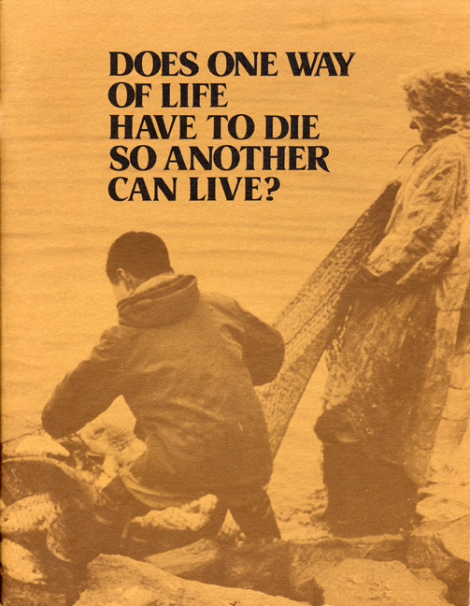

Slide 12
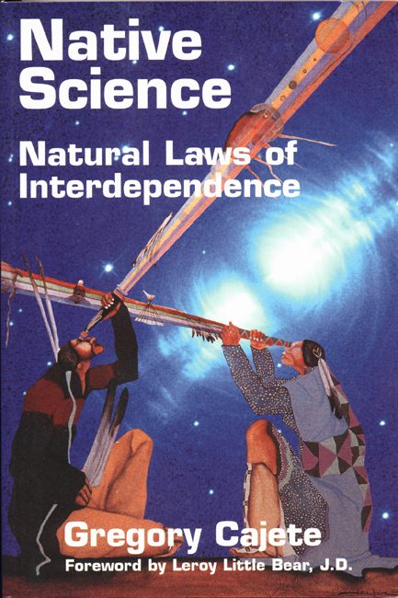

Slide 13
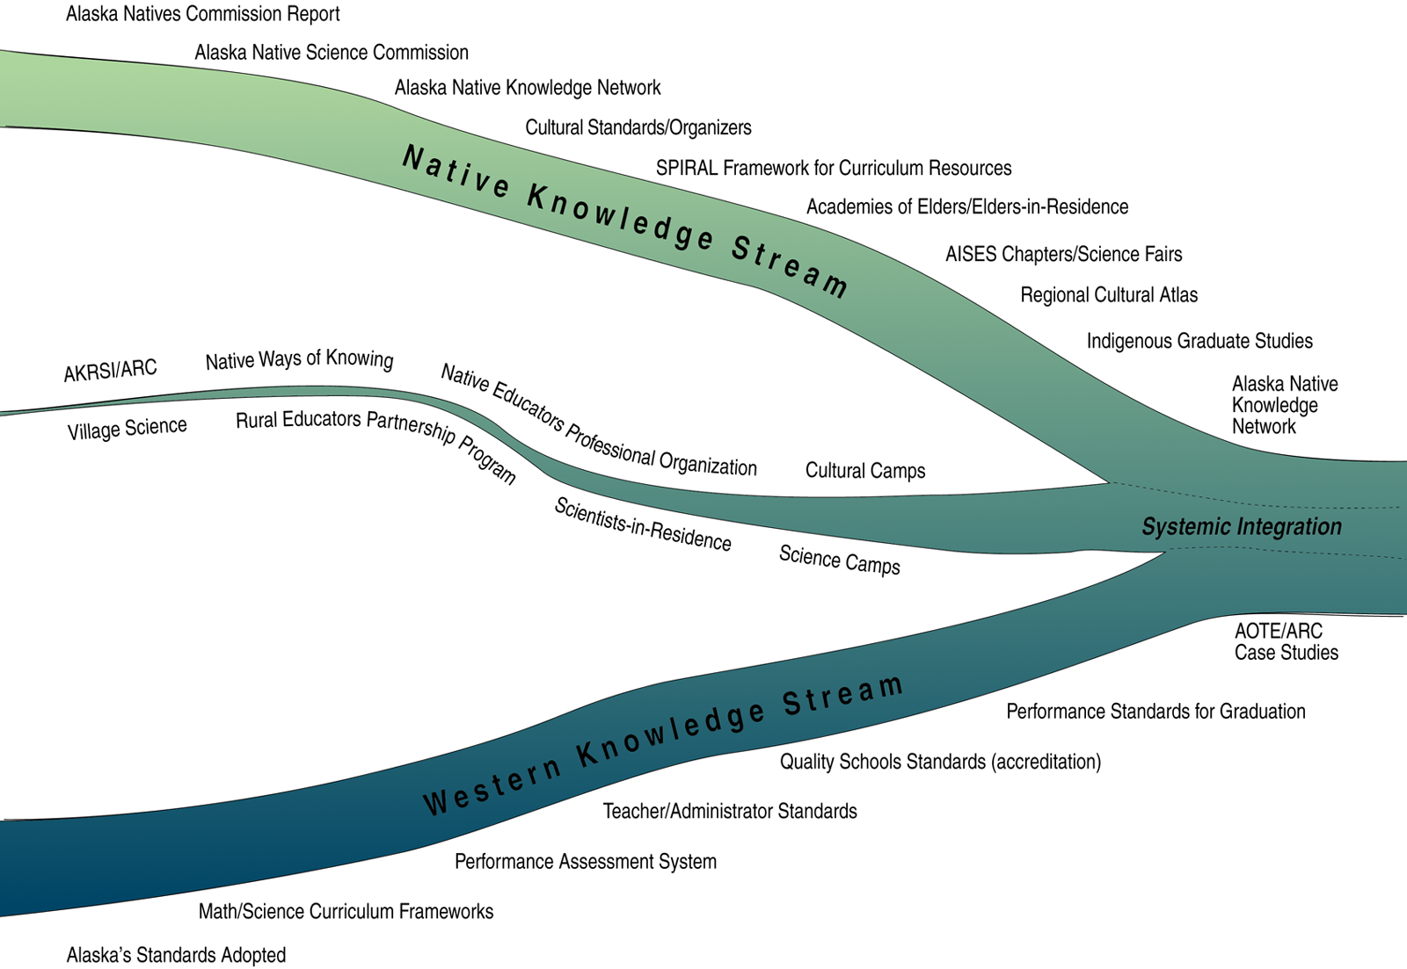

Slide 14
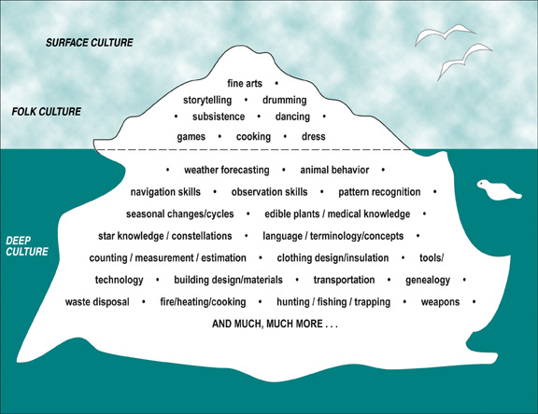

Slide 15
NEO Values

Slide 16
Application of Standards Model
Input/Output
Process/Content
Strategy/Accountability
Standards/Standardization

Slide 17
Alaska Cultural Standards: Students
Assertion:
Culturally knowledgeable students are well grounded in the cultural heritage and traditions of their community
Indicators: Students who meet this standard are able to:
assume responsibility for their role in relation to the well-being of the cultural community and their life-long obligations as a community member;
recount their own genealogy and family history;
acquire and pass on the traditions of their community through oral and written history;
practice their traditional responsibilities to the surrounding environment;
etc.

Slide 18
Curricular Elements in Traditional Knowledge
Weather forecasting
Animal behavior
Navigation skills
Observation skills
Pattern recognition
Seasonal changes/cycles
Edible plants/diet/nutrition
Food preservation/preparation
Rules of survival/safety
Medicinal plants/herbal knowledge
Star knowledge/constellations
Language/terminology/concepts
Counting/measurement/estimation
Clothing design/insulation
Tools/technology
Building design/materials
Transportation
Genealogy
Waste disposal
Fire/heating/cooking
Hunting/fishing/trapping
Weapons

Slide 19
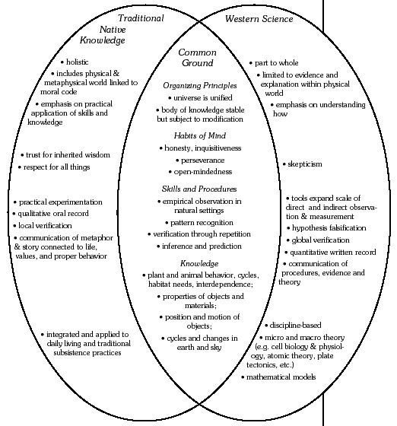
Indigenous Knowledge/Western Science

Slide 20
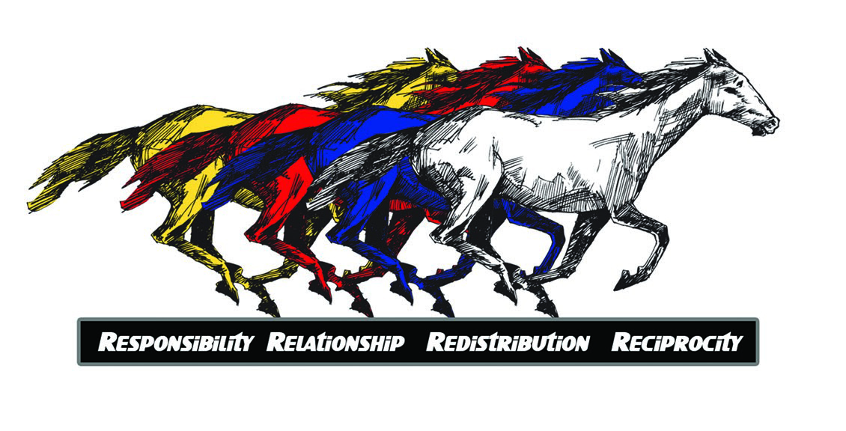
Comanche Centered Education

Slide 21
 | Reciprocity | Redistribution | Relationships | Responsibility
Constructivist Pedagogy | Learning should involve social negotiation and mediation | Current formative assessment informs future learning experiences. | Learning should take place in authentic real-world environments | Content and skills should be made relevant to the learner.
 | Content and skills should be understood within the framework of prior knowledge. | Multiple perspectives and representations of content are sought. | Teachers serve as guides and facilitators. | Learners are encouraged to become self-regulatory, self-mediated, an self-aware.
Comanche Centered Education Practices | Children were encouraged to share equally with one another; selfishness was discouraged. 15 | …advice (from elders) is just as good today as it was in his time. 42 | Whatever the mother or father was doing was keenly observed, and the children were given scraps of materials to make some of these things themselves. 17 | It was the custom to get up very early every morning and do the things that you had planned for the day…for everybody had to be ever ready to meet an emergency of any sort. 32
 | Everybody worked together when travelling and gave assistance to the less fortunate ones…20 | ….parents allowed the children freedom of movement about the encampment, and they were encouraged to express themselves freely. 17 | My father was a great horseman and from his guidance I learned how to handle a horse unafraid, for he had some me all the different ways to handle them. 37 | All these informants emphasized the importance of telling the truth and being trustworthy at all times. 34

Slide 22
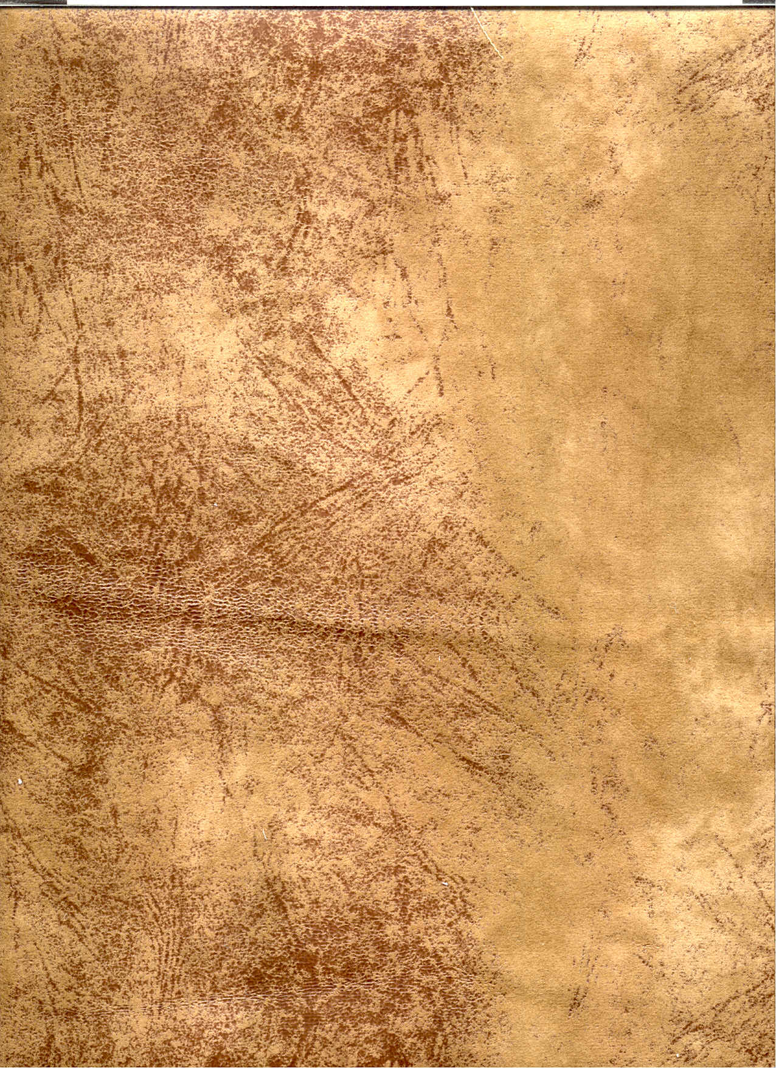
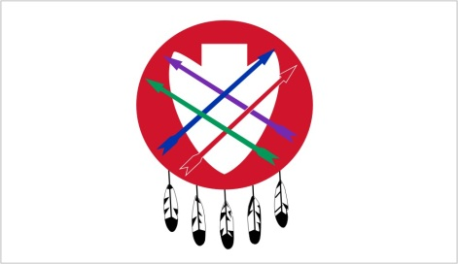





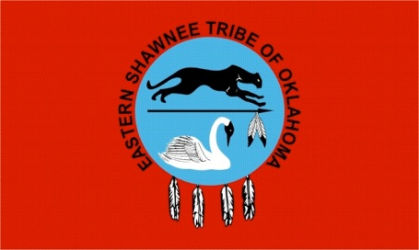


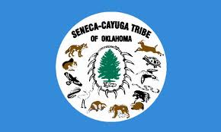
As teachers, we are mentors of our students for all time.
We labor to stand against anger, sadness, criticism, and defeat.
Our hearts shall be full of peace and our minds filled with an urgency for the welfare of our students.
With endless patience, we embrace our duty.
Our firmness shall be tempered with tenderness.
Our words and actions shall be marked by calm deliberation.
Linda Sue Warner, Phd. Naiwen to Talalaka Alfred for his direction to the Gayanashagowe from the Haudenosaunee.

Slide 23
